Slide 1
IBM Next-Generation SOA
Sponsor - Nianjun Zhou, Matt Callery Point of contact - Jialiang Tan Faculty Advisor -Jia Zhang Team - Jialiang Tan,Bin Lan, Yinan Ding,
Samudra Harapan Bekti, Xuan Zhang
Service Oriented Computing (18-655), Fall 2014

Slide 2
Roadmap
Introduction
Motivation
Related work
System design
System implementation
Demo
Experiments/analysis
Conclusions and future work

Slide 3
Introduction
Next Generation SOA
Cloud Computing
Business Mobility
Internet of Things
API
Big Data
IBM Bluemix
A open-standards, cloud-based platform as a service
Java, mobile back-end development, application monitoring, features from ecosystem partners and open source—all provided as-a-service in the cloud

Slide 4
Motivation
Create apps with the efficiency of a cold-blooded cyborg
Rapidly build powerful apps with starters
Advance traditional SOA to cloud-powered next level SOA
Advocate next generation SOA platform by killer app
Notes:
1.Whatever your task, Bluemix contains everything you need to hit the ground running. We've got everything, from IBM-provided services to third-party offerings like Twilio.
Bluemix offers a single solution environment with the instant resources and infrastructure you need to develop and deploy apps across multiple domains—fast.
Get pre-configured sets of services, runtimes, and sample code. Ready for instant deployment.
https://console.ng.bluemix.net/#/home

Slide 5
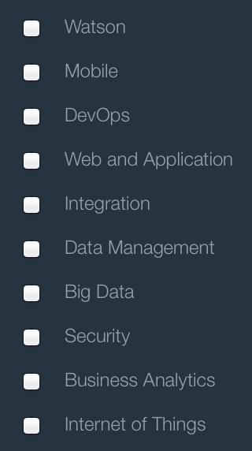
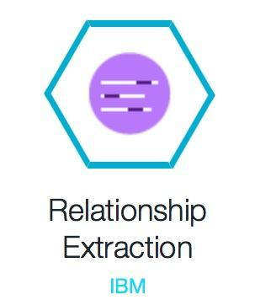
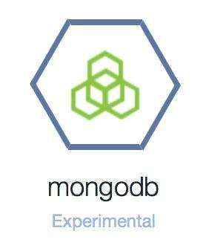
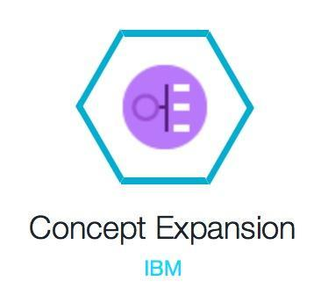
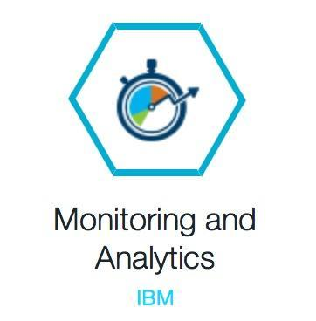
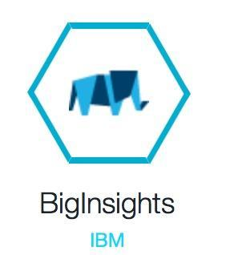
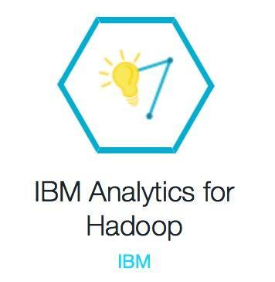
Enterprise Risk Advisor
10K/10Q Forms
Enterprise Risk Advisor APP
Company Financial Situation

Slide 6
Related Work
Previous Summer Project
Enterprise Risk Advisor: A Web 2.0 application that provides web services to analyze, visualize and predict company’s financial situation
ERA applies big data analytics technology to extract and analyze the “Risk factors” for US publicly traded companies, crawlable from 10k forms.
Deficiency
Fail to use IBM BigInsights
Limited IBM Bluemix services integrated into the application
Single data source

Slide 7
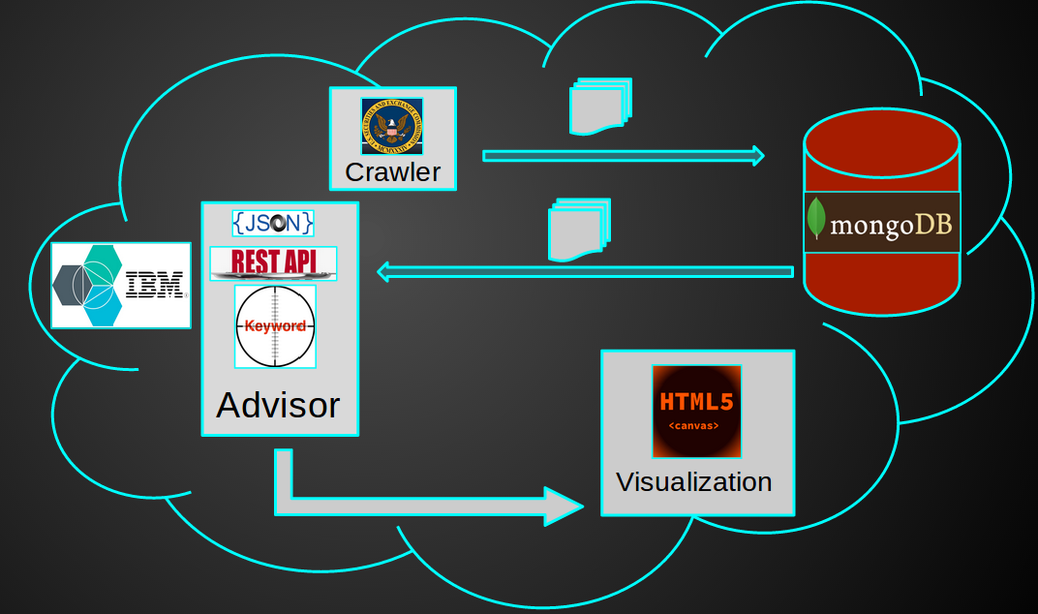
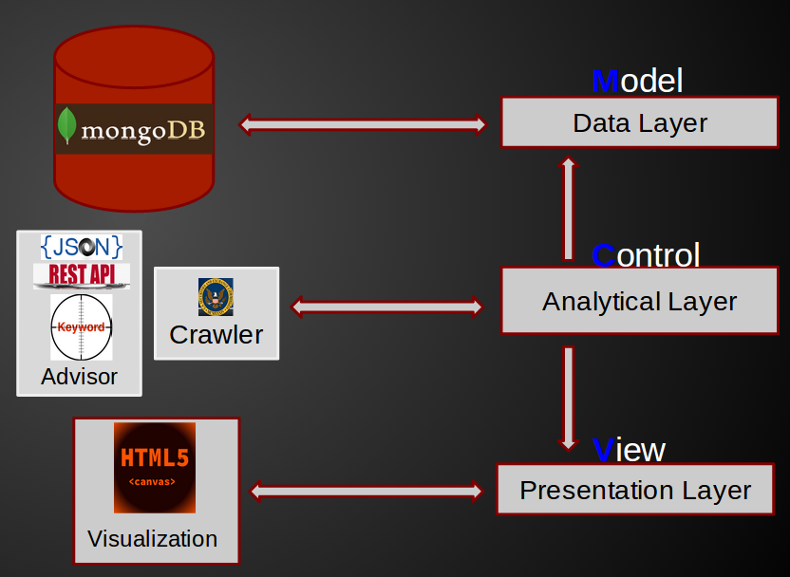
System Design
System Architecture MVC Layer Structure

Slide 8
System Design
The main goal:
On the basis of the concepts of previous project, try to replace hard coding and extend the functionalities to make the application fully integrated with IBM BlueMix.
Our solutions:
Use BigInsight services to replace the original risk analysis algorithm
Text Analytics
Add more BlueMix services into our application
Auto-Scaling
Monitoring and Analytics

Slide 9
Implementation
Goal:
Leverage IBM Bluemix as the platform for building the application.
For that reason, we implemented the whole system exclusively on top of the IBM Bluemix platform.
Our system contains four main parts:
Crawler
Repository
Advisor
Visualization
Notes:
The crawler will retrieve the publicly available 10K and 10Q documents for a given company name from the US government website. It uses a web scraping technique to extract the textual part of the document for further processing by IBM BigInsights. The repository stores the crawled documents as well as the analysis result produced by IBM BigInsights. The advisor defines the 25 types of financial risks and the keyword set for each type of risk for text extraction. Finally, the visualization part displays a comparison of the risk factors by year and for different companies.

Slide 10
Implementation
Crawler:
Implemented using Java EE along with IBM BigInsights module.
Generate the list of URLs of the relevant 10K and 10Q documents based on the stock symbol of the desired company and the desired time range.
The retrieved documents which is in HTML format will be extracted to plain text.
The plain text document then is used as an input for IBM BigInsights analysis module for further text processing.
Notes:
The crawler will retrieve the publicly available 10K and 10Q documents for a given company name from the US government website. It uses a web scraping technique to extract the textual part of the document for further processing by IBM BigInsights. The repository stores the crawled documents as well as the analysis result produced by IBM BigInsights. The advisor defines the 25 types of financial risks and the keyword set for each type of risk for text extraction. Finally, the visualization part displays a comparison of the risk factors by year and for different companies.

Slide 11
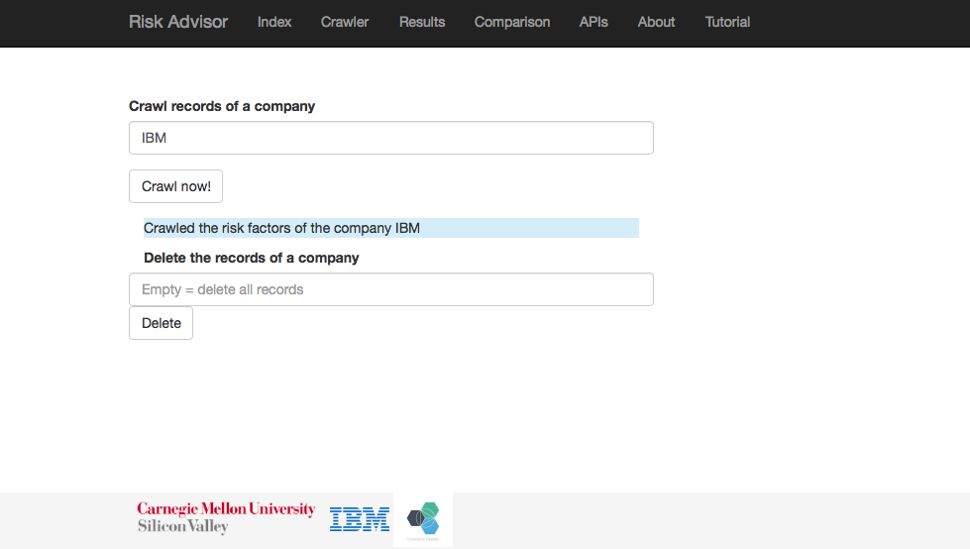

Slide 12
Implementation
Repository:
An instance of MongoDB service on IBM Bluemix.
Stores the plain text 10K or 10Q documents as well as the corresponding risk scores in JSON format.
Notes:
The MongoDB service has a binding support for Java programming language, more specifically for the Liberty for Java runtime environment on IBM Bluemix, which makes storing and retrieving data easier. The MongoDB service instance will not be scaled up or down, unlike the main Java application instance, so no data replication is required.

Slide 13
Implementation
The advisor and the visualization:
The advisor is implemented in JAVA
The visualization component is implemented in HTML5
They work together to present the analysis results to the user
The advisor component takes the stock symbol of the desired company and retrieves the corresponding records from the MongoDB service.
The visualization component takes the records as the input and displays the risk categories in form of histogram and pie chart.

Slide 14
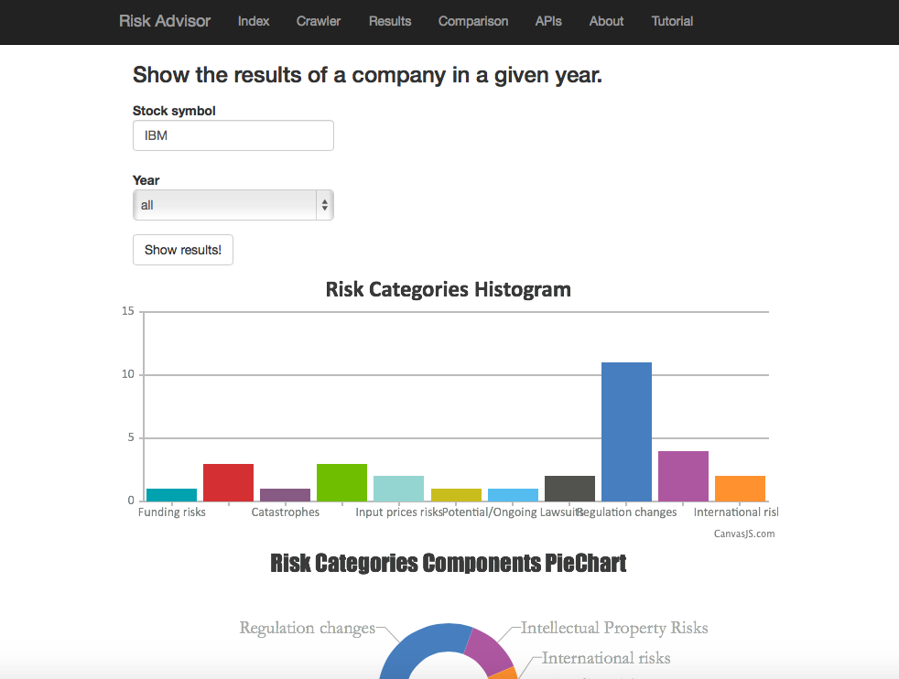

Slide 15
Demo

Slide 16
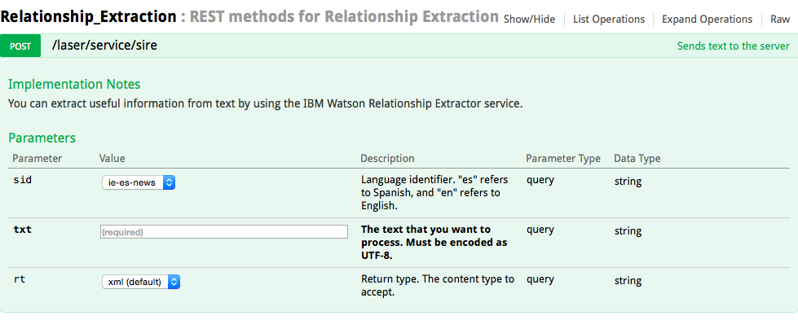
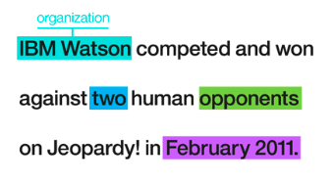
Experiments/analysis
Watson Relationship Extraction
The Watson Relationship Extraction service provides a parser to detect and extract entities for a given sentence (string input). It will return an XML or JSON document which contains all the detected entities and terms from the sentence, such as people’s names, name of places, date, numbers, and so on.

Slide 17
Experiments/analysis
Watson Relationship Extraction - limitation
The concepts of this service is helpful for extracting relevant entities for risk analysis on 10K and 10Q documents.
Not able to detect keywords for risk analysis because the entities are pre-defined
Has limitations on maximum length of string we can pass to the API
Take considerable time to process

Slide 18
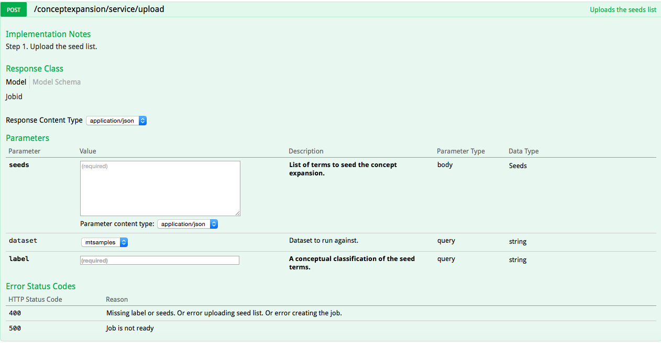
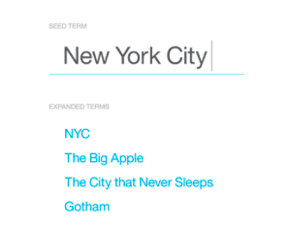
Experiments/analysis
Watson Concept Expansion
The service is able to analyze the text and interprets its meaning based on usage in other similar contexts.

Slide 19
Experiments/analysis
Watson Concept Expansion
Only support two data sets by now: periodically updated random tweets and medical transcript samples from MTSamples
It is still in beta version and we could not expand or modify the data set
May be adopted later

Slide 20
Experiments/analysis
BigInsights Analytics for Hadoop
Pre-built extractor libraries is included to extract a set of entities from input text, or extend the views of these extractors to develop custom extractors
Text Analytics Java API to run the text analytics runtime component from a Java-based application.
Regular expression supported
Perform the text extraction on financial report successfully
Notes:
BigInsights includes pre-built extractor libraries that you can use to extract a set of entities from input text, or extend the views of these extractors to develop custom extractors. This is very useful in analyzing big data. We can also use Text Analytics Java API to run the text analytics runtime component from a Java-based application. For example, we can invoke the Text Analytics API from a basic MapReduce job. One advantage for BigInsights Text Analytics is that regular expression can be used to match and extract the words from text files, which makes processing 10-K and 10-W data more efficiently. We first downloaded the BigInsight Eclipse plugin on local machine to test the word extraction to see if it works. Then we have confident that this can be integrated in our risk analysis project. The Figure X shows the successful word extraction from the financial report.

Slide 21
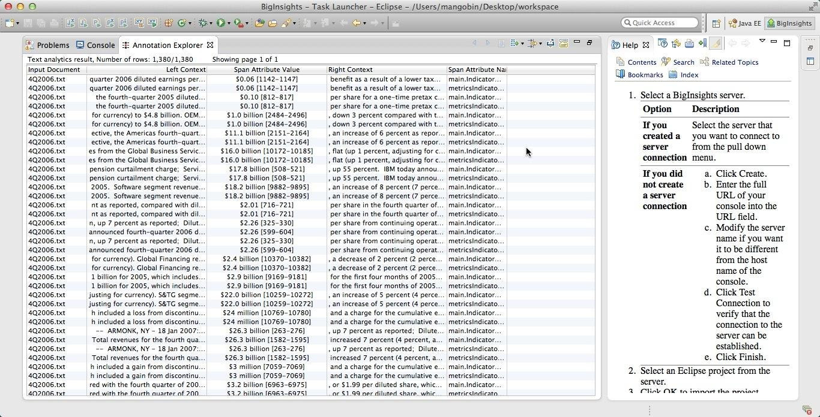

Slide 22
Experiments/analysis
IBM BigInsights Application
Biginsights provides ways to utilize its components to build up customized data processing applications
RESTful APIs to access and manage the file system and applications.
The Text Analytics application framework was used to build the application for keywords extraction and aggregation.

Slide 23
Experiments/analysis
Create a temp file locally storing the 10K/10Q risk factor chapter
Upload the temp file to IBM BigInsights through Restful API
Fire up the predefined big data analysis application through Restful API
Check completion through Restful API
No
Yes
Retrieve the output file through Restful API

Slide 24
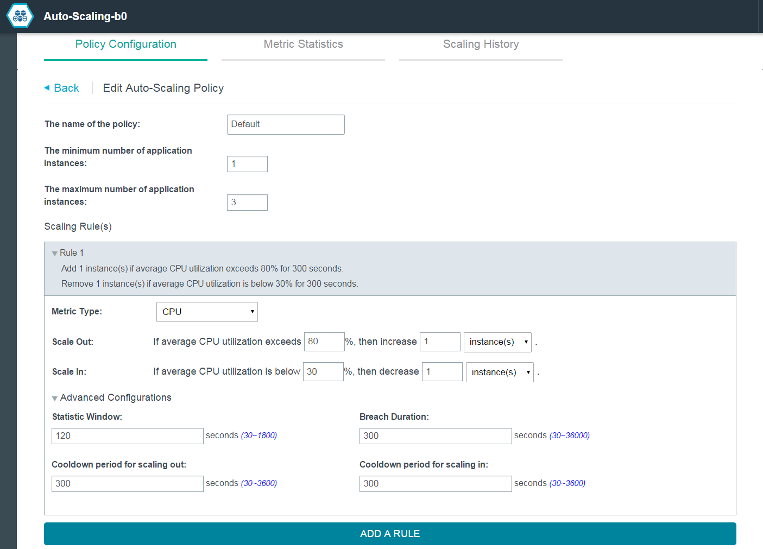
Experiments/analysis
AutoScaling

Slide 25
Experiments/analysis
AutoScaling
Design an experiment to test if MongoDB is shared among scaling instances
Activate one instance A of risk analysis web app;
Crawl IBM’s information from A;
Verify the information accessible from A;
Activate another instance B via Auto-Scaling;
Verify IBM’s information from A;
Verify IBM’s information from B;
Crawl Apple’s information from B;
Verify Apple’s information from A;
Verify Apple’s information from B;
Deactivate B via Auto-Scaling;
Verify IBM’s information from A;
Verify Apple’s information from A;
two instances share one same database. And it makes sense, since we only set the existed database connection address in the code. Auto-Scaling is fully functional.

Slide 26
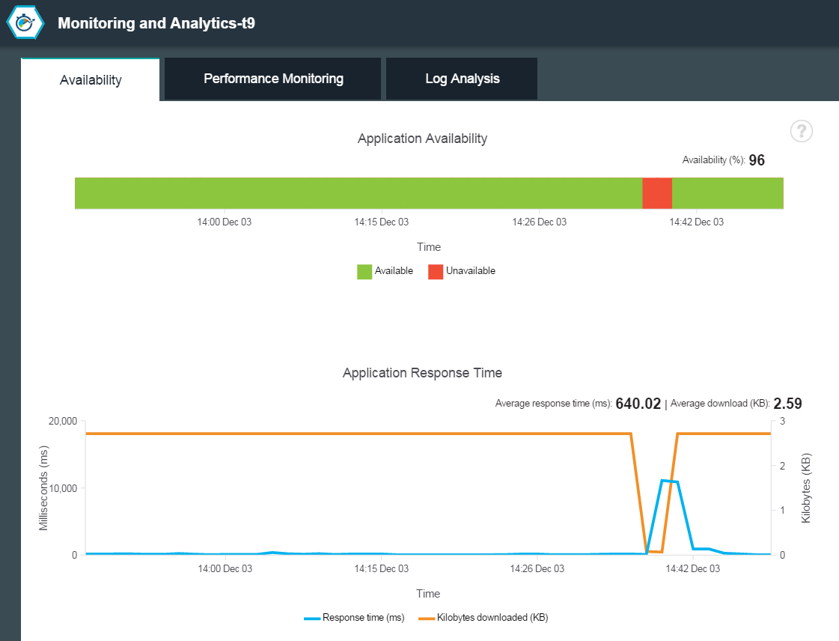
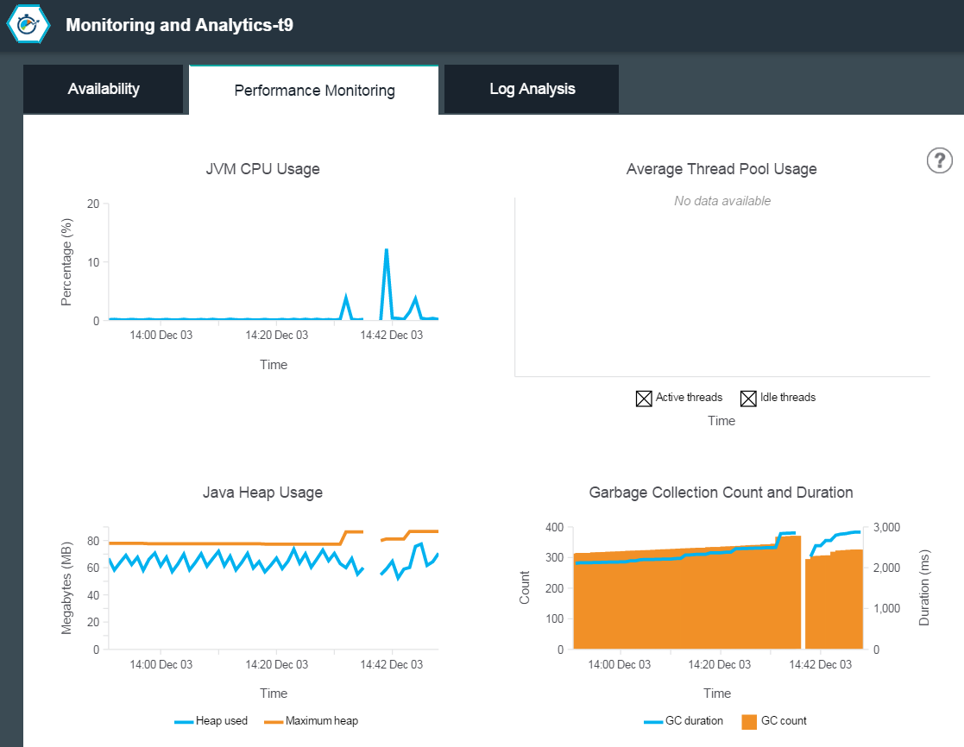
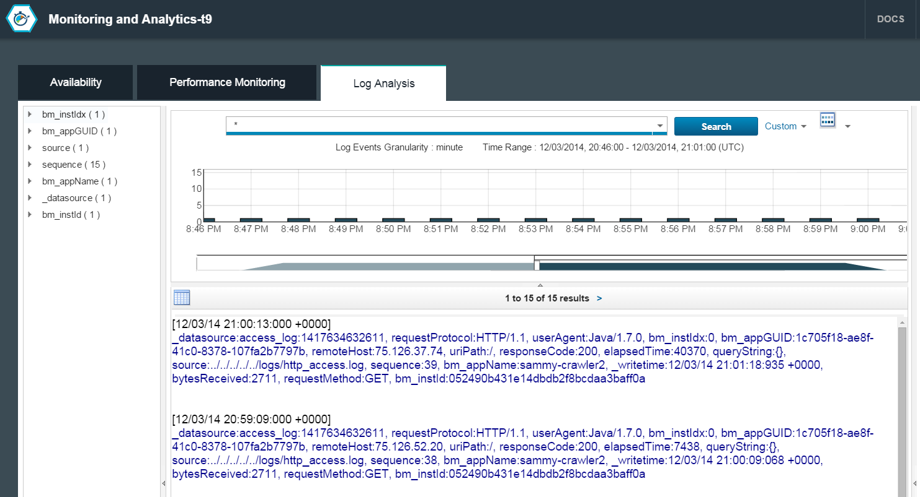
Experiments/analysis
Monitoring and Analytics

Slide 27
Conclusion and future work
Conclusion
This application has successfully fulfilled the planned functionalities and deployed on IBM BlueMix
This application is a sufficient proof of the concept of BlueMix Platform
This application helps to advance the traditional SOA to next generation, cloud-powered SOA
Future Work
Improve risk analysis algorithm to include more risk factor information
Do more precise analytics over the results (Dominance, Correlation, etc)
To enhance UI design to make this application more attractive

Slide 28

Questions?

